Slide 1
LABORATORY OF INFORMATION SECURITY 413-E3

Slide 2
Faculty Members
 | Dr. Nguyen Dai Tho Dr. Le Dinh Thanh Nguyen Xuan Nam Hoang Dang Kien Nguyen Thi Thu Trang

Slide 3
Research in Information Security
Information Security
Network Security
System Security
Privacy
Application Security

Slide 4
Research in Network Security
Countering denial of service attacks
Low rate attacks to TCP
Attacks to websites
Detecting and containing malware propagation
Internet worms
Email worms
Network intrusion detection
Network security monitoring
Anomaly detection
Routing security
Peer to peer networks
Wireless networks

Slide 5
Research in Application Security
Web security
Malware detection
Reverse engineering
Mobile security
Privacy monitoring
Malware analysis
Detection of website vulnerabilities
Protection of websites
Enterprise mobility management

Slide 6
Research in System Security
Offensive Security
Security testing
Hacking
Incident Response
Evidence collection
Digital forensics
CTF (Capture The Flag)

Slide 7
Research in Privacy
User Tracking Prevention
Information inference protection
Domain dependent problems
Private Data Protection
Traffic tracking
Web tracking

Slide 8
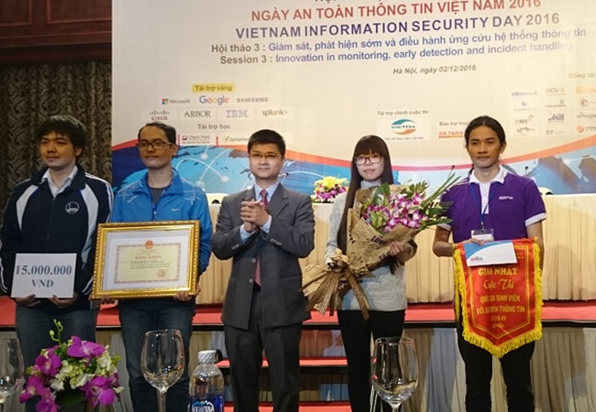
CTF

